Slide 1
How scientists fool themselves and how they can stop
“The most dangerous result is the one you were hoping for.”
„Those who study the science of science joke that the definition of reproducibility itself is not reproducible.”

Slide 2
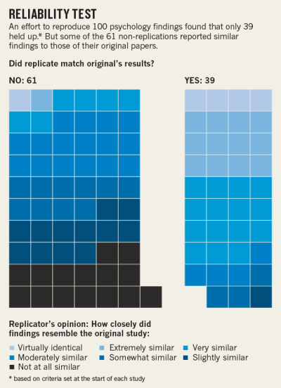

Slide 3
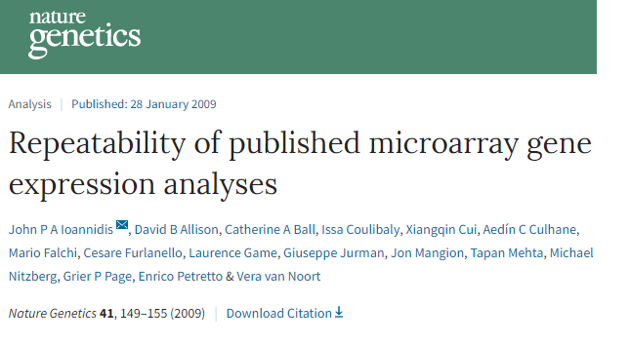
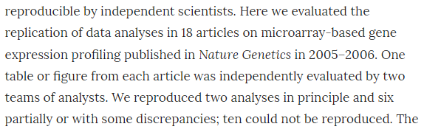

Slide 4
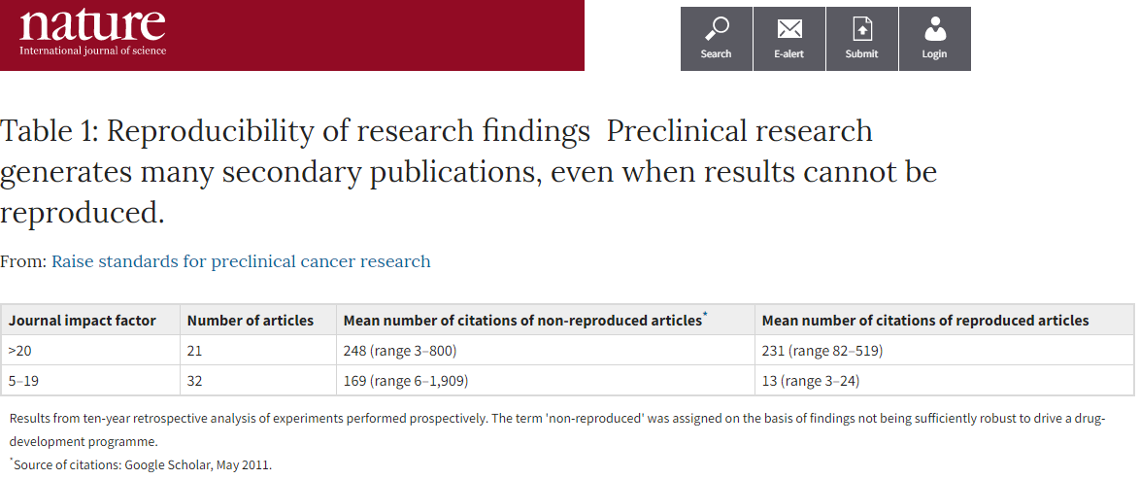
Notes:
Correspondence | Published: 31 August 2011
Believe it or not: how much can we rely on published data on potential drug targets?
Florian Prinz
, Thomas Schlange
& Khusru Asadullah
Nature Reviews Drug Discovery volume10, page712 (2011) | Download Citation
Comment | Published: 28 March 2012
Drug development
Raise standards for preclinical cancer research
C. Glenn Begley
& Lee M. Ellis
Nature volume483, pages531–533 (29 March 2012)

Slide 5

- 6 / 52 reproduced!
- Bayer: 25%
Notes:
A team at Bayer HealthCare in Germany last year reported⁴ that only about 25% of published preclinical studies could be validated to the point at which projects could continue. Notably, published cancer research represented 70% of the studies analysed in that report, some of which might overlap with the 53 papers examined at Amgen.
Some non-reproducible preclinical papers had spawned an entire field, with hundreds of secondary publications that expanded on elements of the original observation, but did not actually seek to confirm or falsify its fundamental basis. More troubling, some of the research has triggered a series of clinical studies — suggesting that many patients had subjected themselves to a trial of a regimen or agent that probably wouldn't work.
Correspondence | Published: 31 August 2011
Believe it or not: how much can we rely on published data on potential drug targets?
Florian Prinz
, Thomas Schlange
& Khusru Asadullah
Nature Reviews Drug Discovery volume10, page712 (2011) | Download Citation
Comment | Published: 28 March 2012
Drug development
Raise standards for preclinical cancer research
C. Glenn Begley
& Lee M. Ellis
Nature volume483, pages531–533 (29 March 2012)

Slide 6
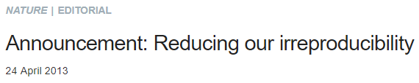
https://www.nature.com/documents/nr-editorial-policy-checklist.pdf
https://www.nature.com/documents/nr-editorial-policy-checklist.pdf

Slide 7
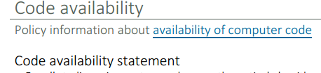
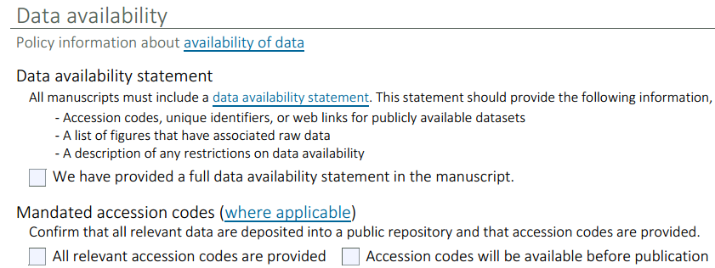
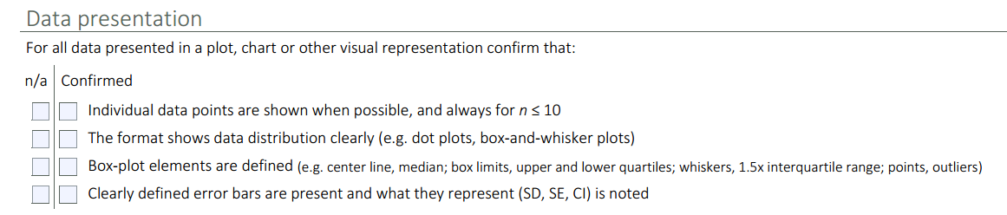

Slide 8
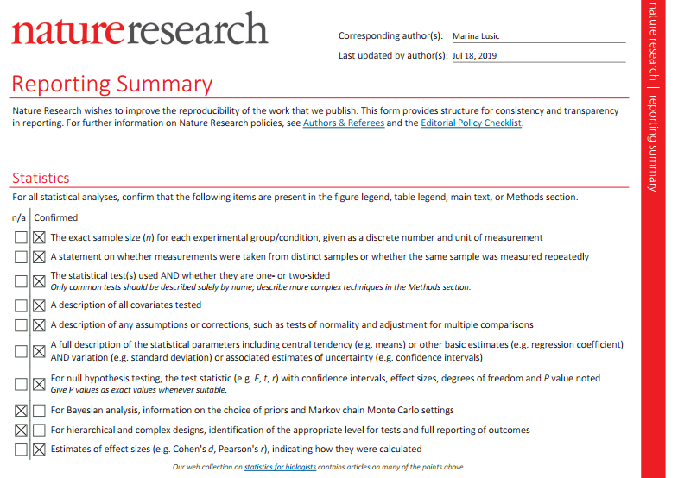

Slide 9
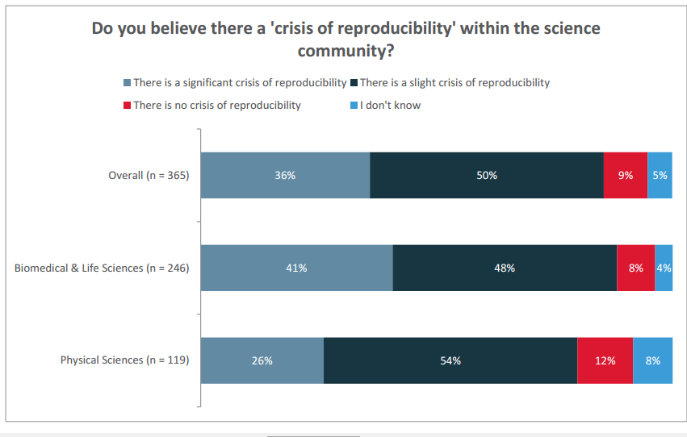

Slide 10
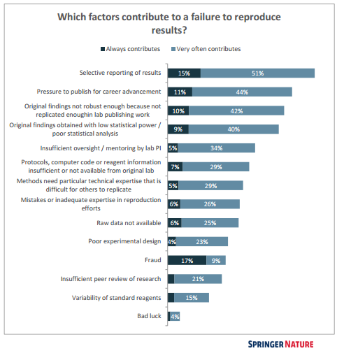
Notes:
https://www.nature.com/articles/d41586-018-04590-7

Slide 11
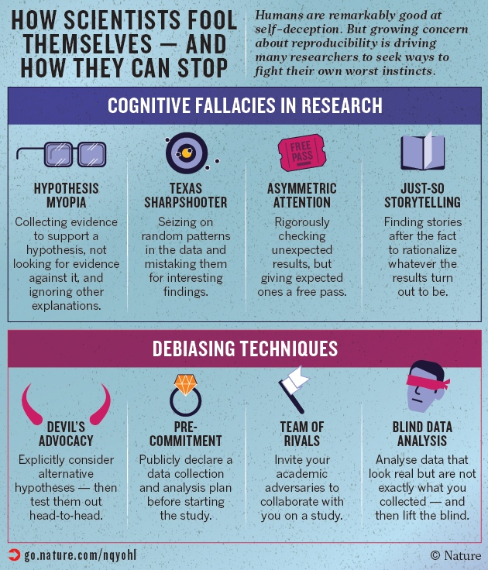
Notes:
Although it is impossible to document how often researchers fool themselves in data analysis, says Ioannidis, findings of irreproducibility beg for an explanation. The study of 100 psychology papers is a case in point: if one assumes that the vast majority of the original researchers were honest and diligent, then a large proportion of the problems can be explained only by unconscious biases.

Slide 12
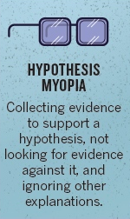

Slide 13



Slide 14
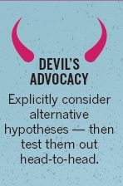

Slide 15
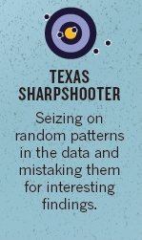
Notes:
Psychologist Uri Simonsohn at the University of Pennsylvania, gives an explicit nod to this naivety in his definition of 'p-hacking': “Exploiting — perhaps unconsciously — researcher degrees of freedom until p < 0.05.” In 2012, a study of more than 2,000 US psychologists⁷ suggested how common p-hacking is. Half had selectively reported only studies that 'worked', 58% had peeked at the results and then decided whether to collect more data, 43% had decided to throw out data only after checking its impact on the p-value and 35% had reported unexpected findings as having been predicted from the start, a practice that psychologist Norbert Kerr of Michigan State University in East Lansing has called HARKing, or hypothesizing after results are known. Not only did the researchers admit to these p-hacking practices, but they defended them.
This May, a journalist described how he had teamed up with a German documentary filmmaker and demonstrated that creative p-hacking, carried out over one “beer-fueled” weekend, could be used to 'prove' that eating chocolate leads to weight loss, reduced cholesterol levels and improved well-being (see go.nature.com/blkpke). They gathered 18 different measurements — including weight, blood protein levels and sleep quality — on 15 people, a handful of whom had eaten some extra chocolate for a few weeks. With that many comparisons, the odds were better than 50–50 that at least one of them would look statistically significant just by chance. As it turns out, three of them did — and the team cherry-picked only those to report.

Slide 16
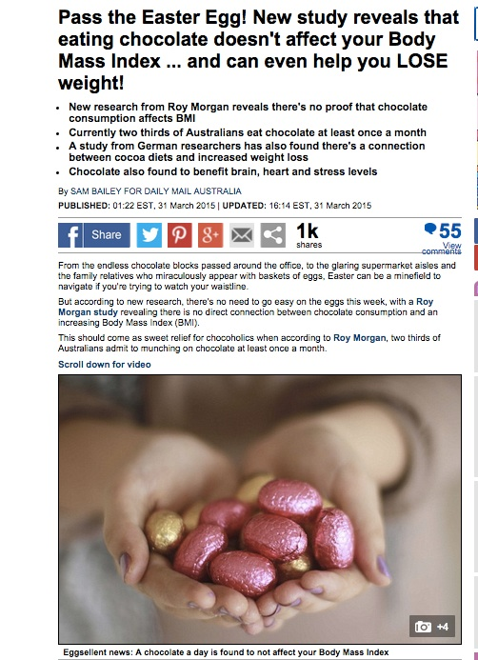
Notes:
This May, a journalist described how he had teamed up with a German documentary filmmaker and demonstrated that creative p-hacking, carried out over one “beer-fueled” weekend, could be used to 'prove' that eating chocolate leads to weight loss, reduced cholesterol levels and improved well-being (see go.nature.com/blkpke). They gathered 18 different measurements — including weight, blood protein levels and sleep quality — on 15 people, a handful of whom had eaten some extra chocolate for a few weeks. With that many comparisons, the odds were better than 50–50 that at least one of them would look statistically significant just by chance. As it turns out, three of them did — and the team cherry-picked only those to report.

Slide 17
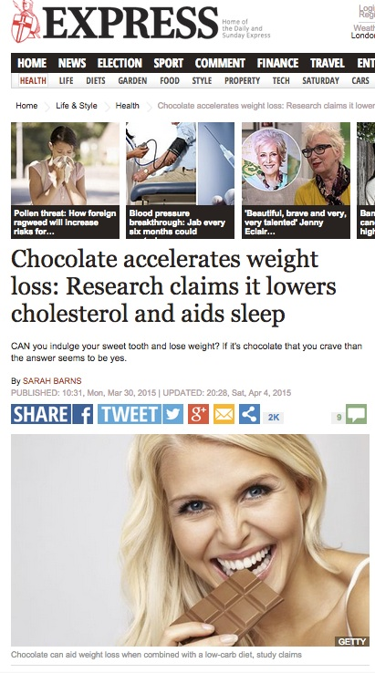
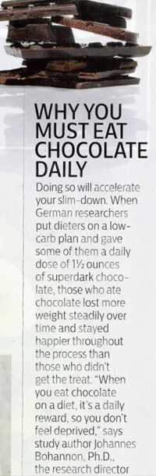
Notes:
This May, a journalist described how he had teamed up with a German documentary filmmaker and demonstrated that creative p-hacking, carried out over one “beer-fueled” weekend, could be used to 'prove' that eating chocolate leads to weight loss, reduced cholesterol levels and improved well-being (see go.nature.com/blkpke). They gathered 18 different measurements — including weight, blood protein levels and sleep quality — on 15 people, a handful of whom had eaten some extra chocolate for a few weeks. With that many comparisons, the odds were better than 50–50 that at least one of them would look statistically significant just by chance. As it turns out, three of them did — and the team cherry-picked only those to report.

Slide 18
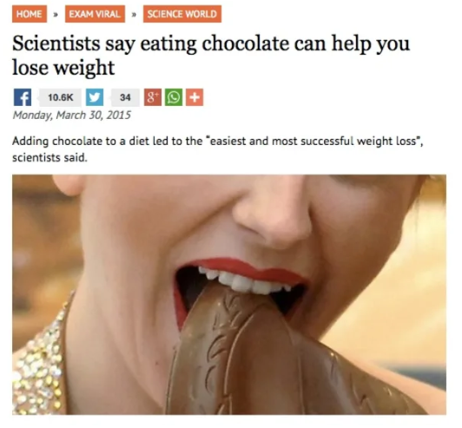
Notes:
This May, a journalist described how he had teamed up with a German documentary filmmaker and demonstrated that creative p-hacking, carried out over one “beer-fueled” weekend, could be used to 'prove' that eating chocolate leads to weight loss, reduced cholesterol levels and improved well-being (see go.nature.com/blkpke). They gathered 18 different measurements — including weight, blood protein levels and sleep quality — on 15 people, a handful of whom had eaten some extra chocolate for a few weeks. With that many comparisons, the odds were better than 50–50 that at least one of them would look statistically significant just by chance. As it turns out, three of them did — and the team cherry-picked only those to report.

Slide 19
Why are p values problematic?
1/1000 people have the disease. False positive rate is 1% and false negative 1%. The results are: positive. What are the odds that you actually have the disease?
100 000 people
100 people 99 900 people
99 ppl 1ppl 999ppl 98901ppl
disease
No disease
Test negative
Test positive
Test negative
Test positive

Slide 20
Why are p values problematic?
1/100 people have the disease. False positive rate is 1% and false negative 1%. The results are: positive. What are the odds that you actually have the disease?
100 000 people
1000 people 99 000 people
990 ppl 10ppl 990ppl ...
disease
No disease
Test negative
Test positive
Test negative
Test positive

Slide 21
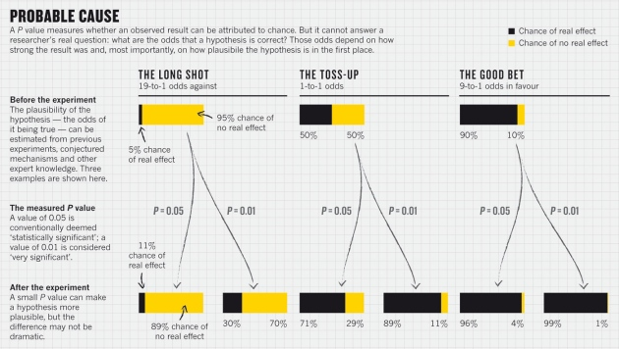
Notes:
https://www.nature.com/news/scientific-method-statistical-errors-1.14700

Slide 22
19,000 people study showed:
those who meet their spouses online are less likely to divorce (p < 0.002) and more likely to have high marital satisfaction (p < 0.001) than those who meet offline
(see Nature http://doi.org/rcg; 2013)
Notes:
https://www.nature.com/news/scientific-method-statistical-errors-1.14700

Slide 23
19,000 people study showed:
those who meet their spouses online are less likely to divorce (p < 0.002) and more likely to have high marital satisfaction (p < 0.001) than those who meet offline
Reality: meeting online nudged the divorce rate from 7.67% down to 5.96%, and barely budged happiness from 5.48 to 5.64 on a 7-point scale
Notes:
https://www.nature.com/news/scientific-method-statistical-errors-1.14700

Slide 24
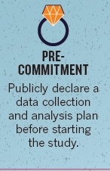
Alternative:
Avoid significant/ non significant
Always report effect size
Always report confidence interval
Notes:
https://www.nature.com/news/scientific-method-statistical-errors-1.14700

Slide 25
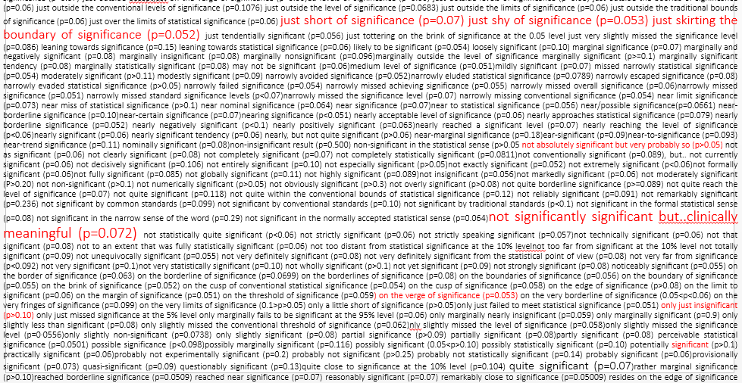
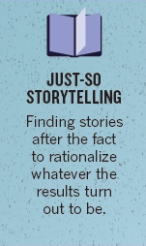
Notes:
JARKing = justifying after results are known

Slide 26

Notes:
JARKing = justifying after results are known

Slide 27
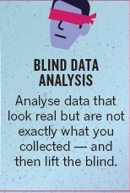
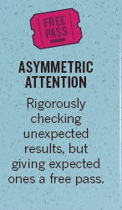
Notes:
The data-checking phase holds another trap: asymmetric attention to detail. Sometimes known as disconfirmation bias, this happens when we give expected results a relatively free pass, but we rigorously check non-intuitive results. “When the data don't seem to match previous estimates, you think, 'Oh, boy! Did I make a mistake?'” MacCoun says. “We don't realize that probably we would have needed corrections in the other situation as well.”
“When the data don't seem to match previous estimates, you think, 'oh, boy! Did I make a mistake?'”
The evidence suggests that scientists are more prone to this than one would think. A 2004 study⁸ observed the discussions of researchers from 3 leading molecular-biology laboratories as they worked through 165 different lab experiments. In 88% of cases in which results did not align with expectations, the scientists blamed the inconsistencies on how the experiments were conducted, rather than on their own theories. Consistent results, by contrast, were given little to no scrutiny.
In 2011, an analysis of over 250 psychology papers found⁹ that more than 1 in 10 of the p-values was incorrect — and that when the errors were big enough to change the statistical significance of the result, more than 90% of the mistakes were in favour of the researchers' expectations, making a non-significant finding significant.

Slide 28
Well...
Good luck.
Notes:
The data-checking phase holds another trap: asymmetric attention to detail. Sometimes known as disconfirmation bias, this happens when we give expected results a relatively free pass, but we rigorously check non-intuitive results. “When the data don't seem to match previous estimates, you think, 'Oh, boy! Did I make a mistake?'” MacCoun says. “We don't realize that probably we would have needed corrections in the other situation as well.”
“When the data don't seem to match previous estimates, you think, 'oh, boy! Did I make a mistake?'”
The evidence suggests that scientists are more prone to this than one would think. A 2004 study⁸ observed the discussions of researchers from 3 leading molecular-biology laboratories as they worked through 165 different lab experiments. In 88% of cases in which results did not align with expectations, the scientists blamed the inconsistencies on how the experiments were conducted, rather than on their own theories. Consistent results, by contrast, were given little to no scrutiny.
In 2011, an analysis of over 250 psychology papers found⁹ that more than 1 in 10 of the p-values was incorrect — and that when the errors were big enough to change the statistical significance of the result, more than 90% of the mistakes were in favour of the researchers' expectations, making a non-significant finding significant.

Slide 29
A P value of 0.05 does not mean that there is a 95% chance that a given hypothesis is correct. Instead, it signifies that if the null hypothesis is true, and all other assumptions made are valid, there is a 5% chance of obtaining a result at least as extreme as the one observed. And a P value cannot indicate the importance of a finding; for instance, a drug can have a statistically significant effect on patients’ blood glucose levels without having a therapeutic effect.

